Slide 1
DIRT: Deferred Image-based Ray Tracing
K. Vardis, A. A. Vasilakis, G. Papaioannou
http://graphics.cs.aueb.gr
Department of Informatics
Athens University of Economics & Business

Slide 2
Introduction
Interactive applications:
strive for visually correct results
need dynamic environments
So:
Global illumination algorithms (e.g. path tracing) with interactive capabilities
Good candidate:
Interactive ray tracing
Notes:
Interactive applications are dependent both on visually correct results as well as on the ability to manipulate the various parameters which constitute a virtual environment. Therefore, the implementation of techniques able to support full global illumination algorithms, such as path tracing, are perfect candidates for this rendering category.

Slide 3
Acceleration data structures
Spatial-based:
Suitable for tracing
High quality
High construction overhead for fully dynamic environments
Highly explored area
Notes:
Traditionally, spatial-based approaches have been highly exploited for this rendering category with well-known advantages and disadvantages.

Slide 4
Acceleration data structures
Image-based/voxel-based:
Compatible with rasterization
Fast construction times -> dynamic environments
Suboptimal acceleration structure
Difficulty to incorporate global effects
Quality issues -> approximate solutions
Memory issues
Recently explored
[Hu 2014], [Ganestam 2014], [Vardis 2016]
Notes:
Image and voxel based methods, being compatible with the rasterization pipeline, can elegantly support dynamic scenes by maintaining high construction times. However, fragment-based tracing produces approximate results and can suffer for memory issues due to the nature of the rasterization pipeline.

Slide 5
Acceleration data structures
Image-based/voxel-based:
Compatible with rasterization
Fast construction times -> dynamic environments
Suboptimal acceleration structure
Difficulty to incorporate global effects
Quality issues -> approximate solutions
Memory issues
Recently explored
[Hu 2014], [Ganestam 2014], [Vardis 2016]
We focus here!
Notes:
This is our focus: improve both on the quality and memory issues of image-based methods while maintaining low construction cost.

Slide 6
Image-based methods
Single layer
Notes:
A quick quality recap. Based solely on the depth-buffer, the result suffers from severe energy loss.

Slide 7
Image-based methods
2 layers
Notes:
2 layers

Slide 8
Image-based methods
5 layers
Notes:
In general, increasing the number of layers within the view consequently increases the captured information and recovers missing energy.

Slide 9
Image-based methods
Single view (all layers ~12)
Notes:
Depending on the viewpoint, we might need everything within the view.

Slide 10
Image-based methods
Entire scene
Notes:
But the entire environment might be required.

Slide 11
Image-based methods - Quality
Based on discretized samples!!
froxel
eye
fragment
ray
Sparse sampling -> inaccurate hits
Notes:
As long as the frequency of phenomena we try to reproduce is limited, the resulting is adequate. This is due to the sampling nature of rasterization which leads to rays passing between fragments and subsequently intersecting with the wrong ones. A fixed thickness parameter can mitigate this but it cannot guarantee accurate intersections.

Slide 12
Image-based methods - Quality
Problem in high frequency effects
Thickness: 0.01m
Notes:
This is mainly visible in high frequency effects. Using a low thickness parameter leads to holes.

Slide 13
Image-based methods - Quality
Problem in high frequency effects
Thickness: 0.01m
Notes:
This is mainly visible in high frequency effects. Using a low thickness parameter leads to holes.

Slide 14
Image-based methods - Quality
Problem in high frequency effects
Thickness: 0.02m
Notes:
Increasing it, covers the holes but introduces erroneous extrusion effects

Slide 15
Image-based methods - Quality
Problem in high frequency effects
Thickness: 0.03m
Notes:
Increasing it, covers the holes but introduces erroneous extrusion effects

Slide 16
Image-based methods - Quality
Problem in high frequency effects
Thickness: 0.05m
Notes:
Eventually, the holes are covered but extrusion effects are dominant.

Slide 17
Image-based methods - Quality
Problem in high frequency effects
No thickness -> analytic tests
Notes:
What we need is analytic intersection tests in order to fully resolve these issues.

Slide 18
Image-based methods - Memory
Build
Traversal
Spatial
ADS
Trace
Fetch
Shade
Rasterization
ADS
Fetch
Trace
Shade
Notes:
When it comes to memory, rasterization-based methods store the shading information before traversal, regardless if they are a part of the illumination computations or not.

Slide 19
Image-based methods - Memory
Build
Traversal
Spatial
ADS
Trace
Fetch
Shade
Rasterization
ADS
Fetch
Trace
Shade
Can lead to excessive allocation cost
Notes:
This can lead to excessive allocation cost for complex environments

Slide 20
Idea
Build
Traversal
Spatial
ADS
Trace
Fetch
Shade
Rasterization
ADS
Fetch
Trace
Shade
Ours
ADS
Trace
Fetch
Shade
Stay on rasterization -> maintain fast construction
Use primitives instead of fragments -> analytic tests
Decouple shading data from construction stage -> reduce memory
Notes:
We tackle these issues by applying the deferred tracing scheme of spatial-based
methods in a rasterization-based ray tracing framework. We store primitive information required for traversal only and disassociate the ADS with the shading data, which is fetched only when required.

Slide 21
Other Contributions
Traversal optimizations:
Primitive-based hierarchical traversal
Depth subdivisions
Lossless buffer downscaling (also reduces memory and construction)
Notes:
Several other techniques are also exploited in order to improve traversal, memory as well as further reduce the construction cost.

Slide 22
Our method
Build
Traversal
Setup Views
Trace
Fill and mipmap Depth
Fetch
Fill Primitives
Shade
Primary Visibility
(optional)
HPG 2016
DIRT: Deferred Image-based Ray Tracing
22
Notes:
Our method consists of three steps:
First, we build our view-based configuration to cover the entire scene, based on previous work.
Then, construction is initiated which fills the acceleration structure with primitive information as well as depth
Finally the scene is traversed in an iterative manner. Details on this later.

Slide 23
Setup Views
Create 6 views based on the main camera view (similar to Vardis et al.[2016])
Notes:
Initially, the scene is covered by arranging 6 views in a cubemap configuration. This is only needed in order to cover the entire environment, but not a necessity. The focus here is on improving the quality and memory of the captured information, not the way it is captured!

Slide 24
Fill Depth
Why? For efficient traversal:
Exploit depth subdivisions for empty space skipping
Perform hierarchical screen-space ray tracing
Notes:
First, we store per-pixel primitive depth information. This step is needed for efficiency purposes. By storing depth information we are able to exploit empty space skipping in the depth-domain and with a subsequent mipmapping step we are also able to perform hierarchical traversal in the image-domain.

Slide 25
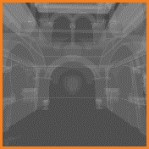
Fill Depth
For each pixel
Z near
Z far
Notes:
So, for each pixel and each incoming primitive

Slide 26
Fill Depth
For each pixel
Z near
Z min
Z max
Z far
Notes:
We perform a clipping operation to capture the min/max bounds of each primitive through atomic operations

Slide 27
Fill Depth
Sampling
location
Z near
Z min
Z max
Z far
Notes:
However, if the primitive is not overlapping the sampling location, a fragment will not be generated.

Slide 28
Fill Depth
Sampling
location
Need conservative rasterization!!
Z near
Z min
Z max
Z far
Notes:
By using conservative rasterization, everything is captured properly.

Slide 29
MipMap Depth
Lod 0
Z near
Z min
Z max
Z far
Notes:
A quick mipmapping step is then performed, where the depth bounds are downscaled and filtered.

Slide 30
MipMap Depth
Lod 0
Lod 1
Z near
Z min
Z max
Z far
Notes:
Iteratively expanding the depth bounds

Slide 31
MipMap Depth
Lod 0
Lod 1
Lod 2
Z near
Z min
Z max
Z far
Notes:
s needed

Slide 32
Fill Primitives
Z near
Z min
Z max
Z far
Notes:
Now, the primitive information is stored by a full geometry pass

Slide 33
Fill Primitives
Assign primitive ids to depth intervals
Z near
Z far
b0
b1
b2
b3
Notes:
Again, we perform a clipping step and based on the stored depth bounds we assign primitives into their overlapping depth intervals

Slide 34
Fill Primitives
Assign primitive ids to depth intervals
Also need conservative rasterization!!
Z near
Z far
b0
b1
b2
b3
Notes:
As before, conservative rasterization is required for capturing everything.

Slide 35
Fill Primitives
ID buffer
heads
Vertex buffer
Notes:
Each depth interval is stored in the form of a linked list in the ID buffer.
A vertex buffer is also filled, in the form of a linear array that contains the per-vertex attribute data of each primitive. Of course, this can be the already generated vertex buffer from the rasterization pipeline.

Slide 36
Final
Notes:
In the end, we end up with an irregular voxel grid

Slide 37

Final
Empty space areas
Notes:
Where grey areas denote empty space areas which can be skipped

Slide 38
Optional: Primary Visibility Pass
eye
P_{k}
P₀
P₂
P₁
P₃
Notes:
Before traversal, we can optionally perform a primary visibility pass, as it comes very cheaply due to rasterization. Of course, if effects such as Depth of Field are needed, this is omitted.

Slide 39
Optional: Primary Visibility Pass
eye
P_{k}
P₀
P₂
P₁
P₃
Notes:
Before traversal, we can optionally perform a primary visibility pass, as it comes very cheaply due to rasterization. Of course, if effects such as Depth of Field are needed, this is omitted.

Slide 40
Traversal
Observation
eye
P_{k}
P₀
P₂
P₁
P₃
Notes:
Let’s move to the Traversal stage.
As shown before, shading data is fetched during traversal as our acceleration structure contains only primitive information.

Slide 41
Traversal
If we move iteratively
eye
P_{k}
P₀
P₂
P₁
P₃
We need to store shading properties only for 3 points
per iteration
Notes:
However, to support an arbitrary number of path events and keep an upper-bound in memory we use the well-known observation that only three points are required per path iteration and so, we allocate storage only for this.

Slide 42
Traversal
e.g. for point P₁
eye
P_{k}
P₀
P₂
P₁
P₃
Use a shading buffer
G₀
G₁
G₂
Notes:
Through a “shading buffer”. For example, for point P1 we need P0,P1,P2

Slide 43
Traversal
e.g. for point P₂, etc
eye
P_{k}
P₀
P₂
P₁
P₃
Use a shading buffer
iteration k
G₁
G₂
G₃
G_{k-1}
G_{k}
G_{k+1}
Notes:
For point P2 we need P1,P2,P3, etc.

Slide 44
Traversal
Trace
Fetch
Shade
Step 1: Start at G_{k}. For each ray move hierarchically in screen space
Notes:
Traversal occurs in three stages. First, during Trace, we spawn a ray from Gk. We first move hierarchically in screen space and, for each sample, in depth space.

Slide 45
Traversal
Trace
Fetch
Shade
Step 1: Start at G_{k}. For each ray move hierarchically in screen space
1x1 Tile
Tip: Can use tiling to speed up tracing
(which also reduces storage and construction cost – see paper)
Notes:
A useful optimization here is through the use of tiling.

Slide 46
Traversal
Trace
Fetch
Shade
Step 1: Start at G_{k}. For each ray move hierarchically in screen space
2x2 Tile
Tip: Can use tiling to speed up tracing
(which also reduces storage and construction cost – see paper)
Notes:
Essentially, we trade traversal overhead in the image-space with larger lists in
the depth domain.

Slide 47
Traversal
Trace
Fetch
Shade
Step 1: Start at G_{k}. For each ray move hierarchically in screen space
4x4 Tile
Tip: Can use tiling to speed up tracing
(which also reduces storage and construction cost – see paper)
Notes:
The traversal improvement depends on the tile density. But, we always obtain significant reduction both in memory and construction cost – details in the paper.

Slide 48
Traversal
Trace
Fetch
Shade
Step 2: For each tile, check in the depth domain
id_{i}
id_{j}
r_{i}
r_{j}
Notes:
So, for each sample (tile) we check in the depth domain for intersection.

Slide 49
Traversal
Trace
Fetch
Shade
Step 2: For each tile, check in the depth domain
id_{i}
id_{j}
r_{i}
r_{j}
Only for the buckets intersected by the ray
Notes:
Bucket skipping ensures we check buckets intersected by a ray

Slide 50
Traversal
Trace
Fetch
Shade
Step 2: For each tile, check in the depth domain
p_{hit}
id_{i}
id_{j}
p_{hit}
p_{i}
id_{i}
p_{i}
p_{j}
p_{j}
id_{j}
r_{i}
r_{j}
and store identified hits in a linked list (at the hit location)
Notes:
For each valid intersection, we store a hit record at the hit location in a linked list since more than one intersections can occur in a pixel. The record contains the starting location of the shading buffer and intersection data, such as barycentric coordinates, etc.

Slide 51
Traversal
Trace
Fetch
Shade
Rasterize at p_{hit}, fetch properties
p_{hit}
p_{i}
p_{j}
and store back at the G_{k+1}[p_{i}], G_{k+1}[p_{j}]
Notes:
Then, we perform a geometry pass, and via a lookup in the linked list we store the properties at the shading buffer, at Gk+1

Slide 52
Traversal
Trace
Fetch
Shade
Compute illumination for iteration k
G₀
+
G₁
+
G₂
and left shift to prepare for iteration k + 1
G₁
<<
G₂
<<
G₃
Notes:
Finally, we compute the illumination for iteration k, based on the stored contents and perform a left shift operation to prepare for the next event.

Slide 53
Results
Fragment-based tracing: Single view (all layers ~12)
1024x512
Tracing times per ray path
GTX 980 Ti
Memory: 170MB
Construction: 16.5ms
Tracing: 15ms
Notes:
Some results. Comparison against fragment based tracing using a single view using good (not optimal) quality settings for the fragment-based approach. Memory is 170MB, Construction 16.5ms and Tracing 15ms.

Slide 54
Results
Primitive-based tracing: Single view (all layers ~12)
1024x512
Tracing times per ray path
GTX 980 Ti
Memory: 123MB
Construction: 2.5ms
Tracing: 21ms
Notes:
Our analytic tests remedies the remaining missing energy and reduces memory to 123MB and Construction to only 2.5ms. Tracing is more expensive in this particular viewpoint. This is due to larger lists and the absence of sorting, but this is not always the case as missed ray hits in fragment-based tracing may result in more expensive tracing times. Therefore, it does not make sense to perform a comparison in traversal times against fragment-based tracing as it is approximate.

Slide 55
Results
Fragment-based tracing: Entire scene
1024x512
Tracing times per ray path
GTX 980 Ti
Memory: 691MB
Construction: 21ms
Tracing: 30ms
Notes:
Same example using the entire scene. Memory is 691MB, Construction 21ms and Tracing 30ms.

Slide 56
Results
Primitive-based tracing: Entire scene
1024x512
Tracing times per ray path
GTX 980 Ti
Memory: 205MB
Construction: 6.5ms
Tracing: 65ms
Notes:
We recover the missing energy and reduce storage and construction by almost 70%.

Slide 57
Results
Build (ms)
Traversal (ms)
30
400
25
300
20
200
15
100
10
5
0
1
8
16
24
32
38
40
1
8
16
24
32
38
40
Depth Subdivisions
Depth Subdivisions
Cloth
Sponza
Dirt
1x1
2x2
4x4
Notes:
Construction and traversal timings against different depth subdivisions settings on 1024x512 resolution. The notable observation here is the impact of tiling in both and the exponential benefit of bucketing in traversal.

Slide 58
Results - Optix
Primitive-based (top) vs OptiX (bottom)
Direct + Visibility
Direct + Indirect (No Vis)
Direct + Indirect + 2 Vis
Notes:
Quality comparison against OptiX. As expected, the results are identical (sampling differences aside)

Slide 59
Results - Optix
Time (ms) vs Image Size (MPixels)
Direct + Visibility
Direct + Indirect (No Vis)
Direct + Indirect + 2 Vis
300
~550
250
200
150
100
50
0
0.125
1
2
0.125
1
2
0.125
1
2
DIRT
TRBVH
HLBVH
Build
Total
Uses shadow map
Notes:
In terms of performance, we maintain a very low construction cost against two highly optimized data structures. However, when we move to incoherent rays, traversal becomes expensive and we benefit only in lower resolutions.

Slide 60
Results - Memory
Memory Size (GB) vs Fragments
3.0
2.5
2
1.5
1
0.5
0
1M
8M
16M
24M
32M
40M
[Vardis et al. 2016]
DIRT
512X512
1024x1024
1920x1080
Notes:
Our memory reduction is shown in this theoretical example. We exhibit a near constant relation with the fragment generation as opposed to a linear one in previous methods.

Slide 61
Results
Quality
Accurate -> thickness is no longer required
Performance
The deferred scheme and the tiling optimization both significantly reduce construction cost
Bucketing provides exponential benefits to traversal
Traversal benefits depend on tile density
Memory
The deferred scheme can provide significant reduction in memory requirements
Each increase in tile size further drops memory cost in ~half
Notes:
To conclude, we have managed to improve image-space ray tracing in several areas.
First and most important quality, as the thickness parameter is no longer required
Second, performance. The construction cost is lower, and traversal is, when hierarchical traversal is used, faster in general as we do not miss hits due to sparse sampling.
Finally, memory is significantly improved through the deferred scheme and tiling.

Slide 62
Limitations – Future work
Memory
Preallocating a fixed number of buckets
Performance
Conservative rasterization and incoherent rays pose a severe penalty in traversal
Future work
Optimize the data structure (adaptive subdivision, etc)
Explore coherence strategies
Notes:
We still have lots of open problems. First, memory can be further reduced by not preallocating the head pointers required for the linked lists.
Second, and most important, the irregular increase in fragments for oblique surfaces through conservative rasterization and ray incoherence (in secondary rays) pose a bottlenect in our traversal times.
We aim to further inverstigate on both of these.

Slide 63
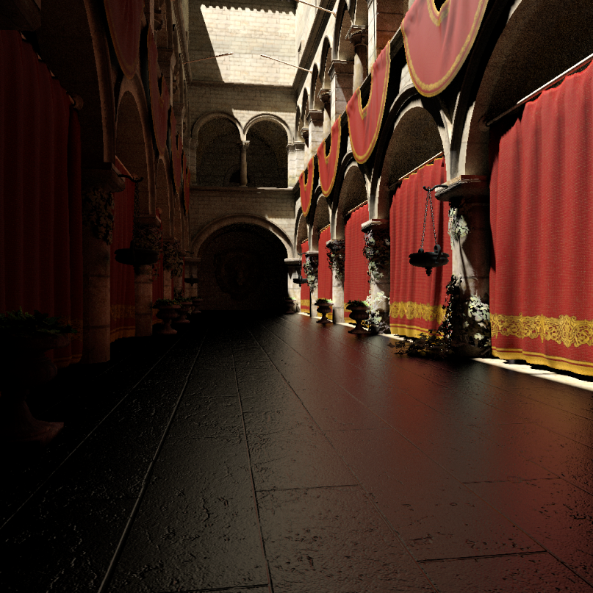
Thank You
Paper and source code at:
http://graphics.cs.aueb.gr/graphics/research_illumination.html
Questions?
Notes:
In this work, we generalized and improved image-space ray tracing even further, in almost all areas. We hope that the ideas presented here will provide a novel insight in an area with renewed search interest.
Thank you!

